Slide 1
DISPLAY BOARDS
Surfaces designed for presentation of visual learning materials. The display may include a variety of learning material such as diagrams, pictures, photographs, news clippings, three dimensional objects and specimens
Dr. Mwancha - Education Department

Slide 2
Functions of displays
Motivational
Developmental
Summary
Reporting on student activities
Reporting on notices of events
Display of regulations
Reporting of new events and developments
Dr. Mwancha - Education Department

Slide 3
Motivational – A good display can attract and appeal to the learners, stimulate curiosity and imagination. Motivational displays are arranged by the teacher
Developmental – During discussion a display may add information for fixing up ideas in the minds of learners. A developmental display should actively involve learners both in planning and execution
Dr. Mwancha - Education Department

Slide 4
Summary – At the end of the lesson, a display may be used for review and consolidation
Dr. Mwancha - Education Department

Slide 5
Display surfaces
Flannel boards
Magnetic boards
White boards
Chalk board
Bulletin board
Peg board
Dr. Mwancha - Education Department

Slide 6
Flannel board
Also called the felt board
It is a board covered with felt, flannel or other suitable cloth. These materials have a fibre surface and similar materials will adhere to them
Flat light weight teaching materials can be cut out from flannel and used. Pictures cut out from books and backed with a small bit of sand paper can be used directly over the flannel board
Dr. Mwancha - Education Department

Slide 7
Advantages of flannel boards
Materials for construction are readily available
Positions of items on the board can easily be changed quickly
Light 3D objects can be displayed
Materials can be used on it for lesson summary
Dr. Mwancha - Education Department

Slide 8
Disadvantages of flannel boards
Needs a lot of care, otherwise wear and tear are very high
Practice and preparation are required for effective use
Takes time in preparing the materials
Dr. Mwancha - Education Department

Slide 9
Magnetic board
Are made from mild steel and can be painted with chalk board paint or white board paint. Thus can be used as white board or chalk board
Dr. Mwancha - Education Department

Slide 10
Advantages of the magnetic board
Provides greater adhesive quality hence displays can not easily fall off
It is multipurpose ie. Can be used as chalk board or white board
Items can be quickly added, removed or their positions changed
Dr. Mwancha - Education Department

Slide 11
Disadvantages of the magnetic board
Expensive
Bulky and heavy
Dr. Mwancha - Education Department

Slide 12
White boards
Has a white surface
It should be used with water soluble inks
Advantages
- Colours are seen best on white boards
- No dust, hence no health risk
Disadvantages
- Materials used are expensive
- Problem of ghosting is much more a cute
- Difficult to clean it
Dr. Mwancha - Education Department

Slide 13
The chalkboard
The most common display surface in the classroom on which to write or draw on using a piece of chalk.
Chalkboards can either be black, blue, green or any other colour that reduces glare and provides good legibility.
Dr. Mwancha - Education Department

Slide 14
Types of chalkboards
Some of the types include:-
Fixed chalkboard
Portable chalkboard
Sliding chalkboard
  horizontal sliding
  vertical sliding
Folding chalkboard
Dr. Mwancha - Education Department

Slide 15
Fixed chalkboard
Is permanently mounted on a wall or part of the wall is painted to serve as a board.
It is always available when needed.
Usually, it is large thus providing ample space for display.
It is cheap to install and maintain....are not easily damaged
However some parts may not be easy to reach due to height.
Dr. Mwancha - Education Department

Slide 16

Fixed Chalkboard (wall-mounted)
Dr. Mwancha - Education Department

Slide 17
Portable chalkboard
Is usually mounted on a stand that allows it to be moved from place to place.
It can be used outside the classroom or in other classrooms with different classes.
It enables the teacher to plan or draw sketches before the actual lesson.
However, it has a small display surface; is easily damaged and can be misplaced too.
Dr. Mwancha - Education Department

Slide 18
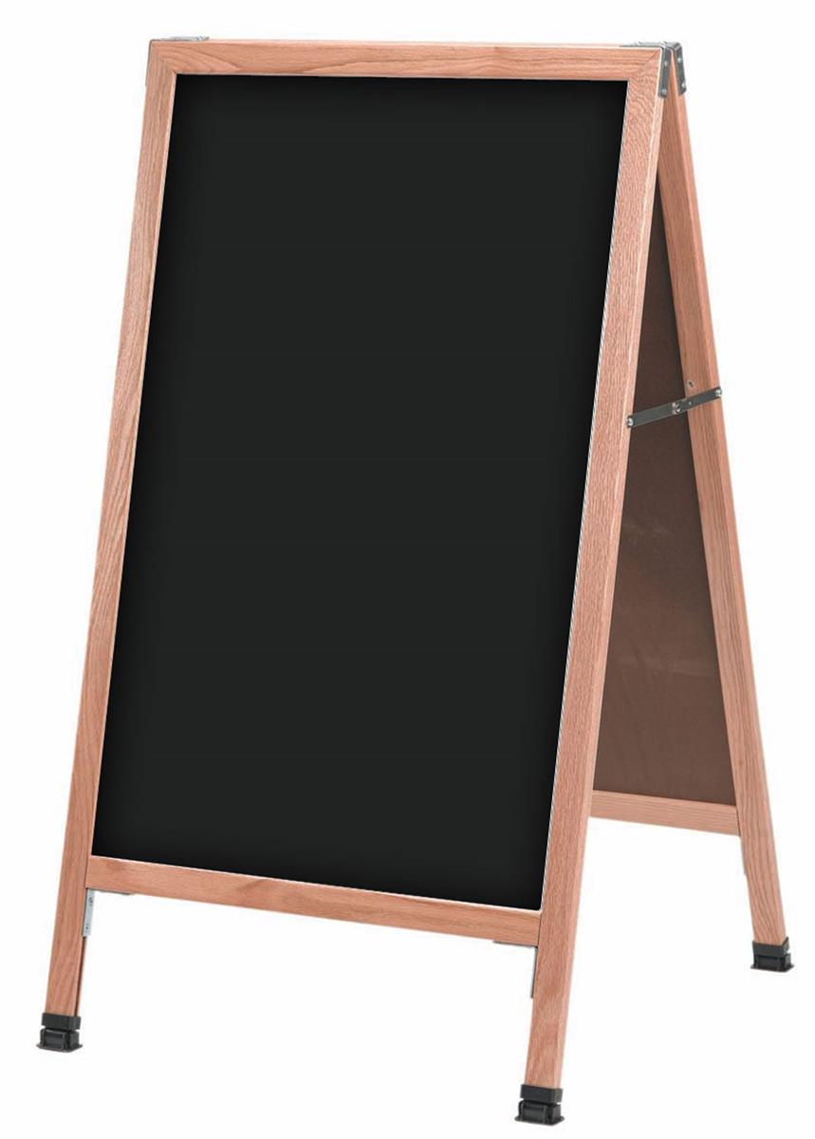
Portable Chalkboard
Dr. Mwancha - Education Department

Slide 19
Sliding chalkboards
Two or more parts of the chalkboard slide across and over each other using rollers (horizontal) or pulleys (vertical).
They can be used to store and conceal information and display it when needed.
One can adjust the height to write on the highest or lowest level.
are expensive to install and maintain.
Rollers and pulleys may get stuck
Dr. Mwancha - Education Department

Slide 20
Folding chalkboards
Two or more parts of the board are held together by hinges that allow the parts to ‘open and close’ when being used.
They provide ample space to work on.
Can store and conceal information
However, they are expensive to install and maintain
Dr. Mwancha - Education Department

Slide 21
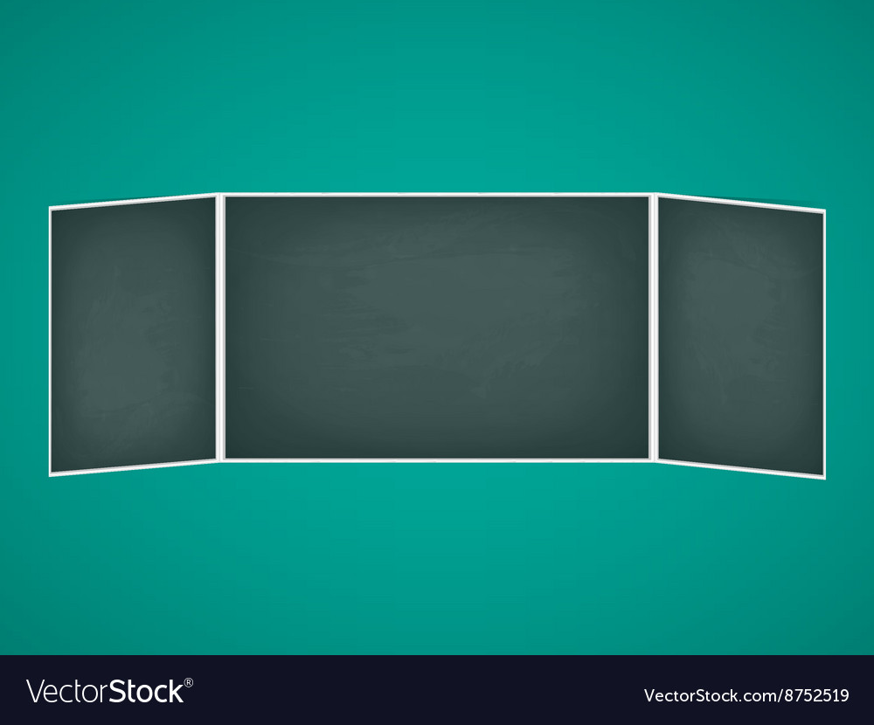
Folding Chalkboard
Dr. Mwancha - Education Department

Slide 22
Uses of the Chalkboard
for systematic display of the entire subject matter of a lesson taught.
developing lesson summary/ main points.
engaging class in working out examples or solutions and answering oral questions.
record pupil’s ideas and suggestions.
clarify new terms, concepts or keywords
develop drawings, sketch, illustration
mount wall charts and other learning resources for common class viewing
Dr. Mwancha - Education Department

Slide 23
Planning Chalkboard Use
Set out how to use the chalkboard when lesson planning..consider the nature/type of board and lesson needs
Plan in advance what to write, where and when to write it…use a simple illustration to show chalkboard layout.
Gather chalkboard materials before the lesson to avoid waste of time once lesson starts
Dr. Mwancha - Education Department

Slide 24
Techniques of chalkboard use
Ensure surface of the board is clean
Divide CB into manageable portions
Write the date, subject..title at the start
Involve learners to develop chalkboard work :lesson summary, drawings…
Print neatly rather than using script
Keep the head at the height at which you are writing.
Use a pointer to direct pupils’ attention to essential details on the board.
Dr. Mwancha - Education Department

Slide 25
Techniques of chalkboard use
Check legibility of chalkboard work from several positions of the class.
Writing to be uniform in style and size.
Leave enough space between words to increase legibility
Face or maintain eye contact with class while explaining a point.
Stand in a position such that the board can be reached easily when writing.
Move around so that you do not block learners’ view of the board.
Dr. Mwancha - Education Department

Slide 26
Advantages of the chalkboard
Requires no special talent or equipment
Is versatile (many uses) and adaptable to the requirements of all subjects
Is cheap and inexpensive
Changes/corrections can be made easily
Help learners perceive information with ease.
Can be used alongside other resources.
Is always available for use ( fixed)
Dr. Mwancha - Education Department

Slide 27
Disadvantages
Illustrations on the board are not to scale and may give wrong impression.
Easy to write a word wrongly and if not corrected pupils learn with errors
Chalkboard work is easily erased thus information can not be stored for long.
Teacher keeps turning head away from pupils thus breaking eye contact.
Chalk dust may be harmful.
Dr. Mwancha - Education Department

Slide 28
White boards
A smooth white plastic display surface on which to write or draw using special marking pens rather than chalk.
The white nonglare surface is also suitable for projection of instructional films, slides, e.t.c.
They usually have a steel backing and can be used as magnetic boards for display of visuals.
Dr. Mwancha - Education Department

Slide 29
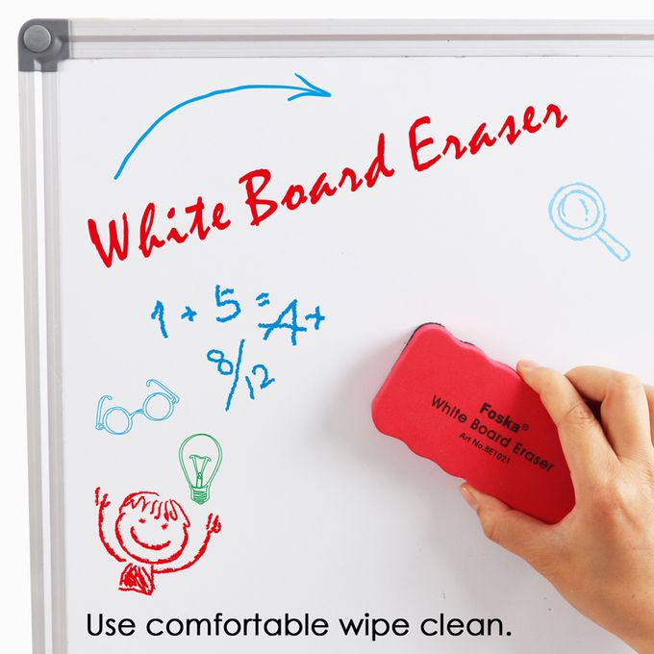
Dr. Mwancha - Education Department

Slide 30
Advantages of Whiteboards
Multipurpose- has several instructional use.
Present clearer visuals than chalkboards because of nonglare surface
Clean and dustless
Can be used in rooms that does not require dust..e.g. computer rooms
Dr. Mwancha - Education Department

Slide 31
Disadvantages of Whiteboards
Ghosting problem is more acute
Has smaller surface than chalkoard
Materials used are more expensive..pens
It is expensive to install and maintain.
Dr. Mwancha - Education Department

Slide 32
Bulletin boards
A surface made of material on which visuals are displayed using pins, thumbtacks and other sharp fasteners.
Are commonly referred to as the notice board.
The term bulletin implies brief news or announcements of urgent interest.
Dr. Mwancha - Education Department

Slide 33
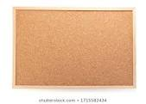
Bulletin Board (Unused)
Dr. Mwancha - Education Department

Slide 34
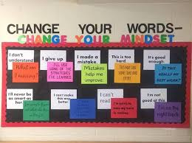
Bulletin Board (Used)
Dr. Mwancha - Education Department

Slide 35
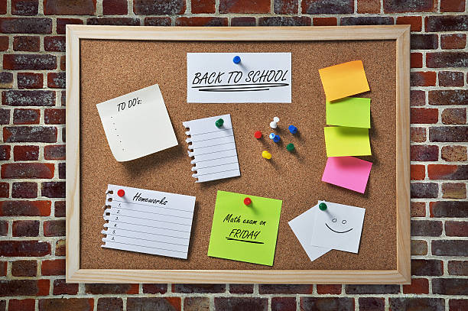
Bulletin Board (Used)
Dr. Mwancha - Education Department

Slide 36
Application of Bulletin boards
Instructional- mount visuals for common class view and participation to complement learning objectives being pursued.
Motivational- display good student work to encourage creativity and better work.-Arouse learner interest in a topic and motivate them to do further study or research
Decorative – lend visual stimulation to an environment that would rather be dull
Dr. Mwancha - Education Department

Slide 37
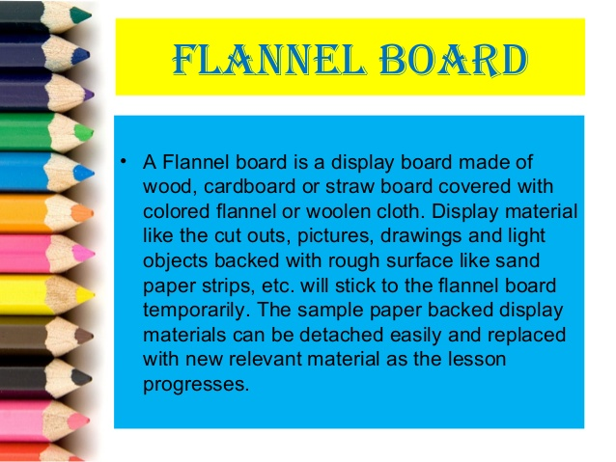
Flannel or Cloth Board
Dr. Mwancha - Education Department

Slide 38
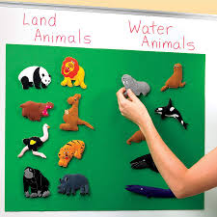
Example of used Flannel Board
Dr. Mwancha - Education Department

Slide 39
Magnetic Boards
Magnetic whiteboards have a steel foundation under the dry-wipe writing surface.
This steel backing allows users to attach magnetic objects on the board, making it easy to stick and display documents, notes and items using small magnets or magnetic strips.
When using a magnetic board as a notice board, using push pins becomes unnecessary, reducing the chances of injuries.
Dr. Mwancha - Education Department

Slide 40
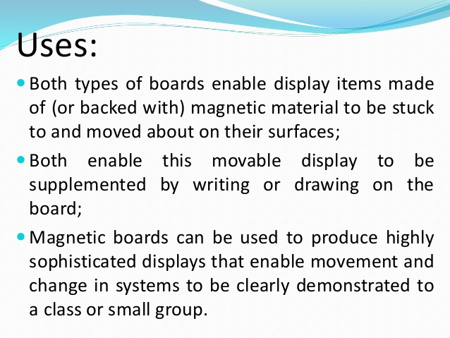
Magnetic Whiteboard
Dr. Mwancha - Education Department

Slide 41
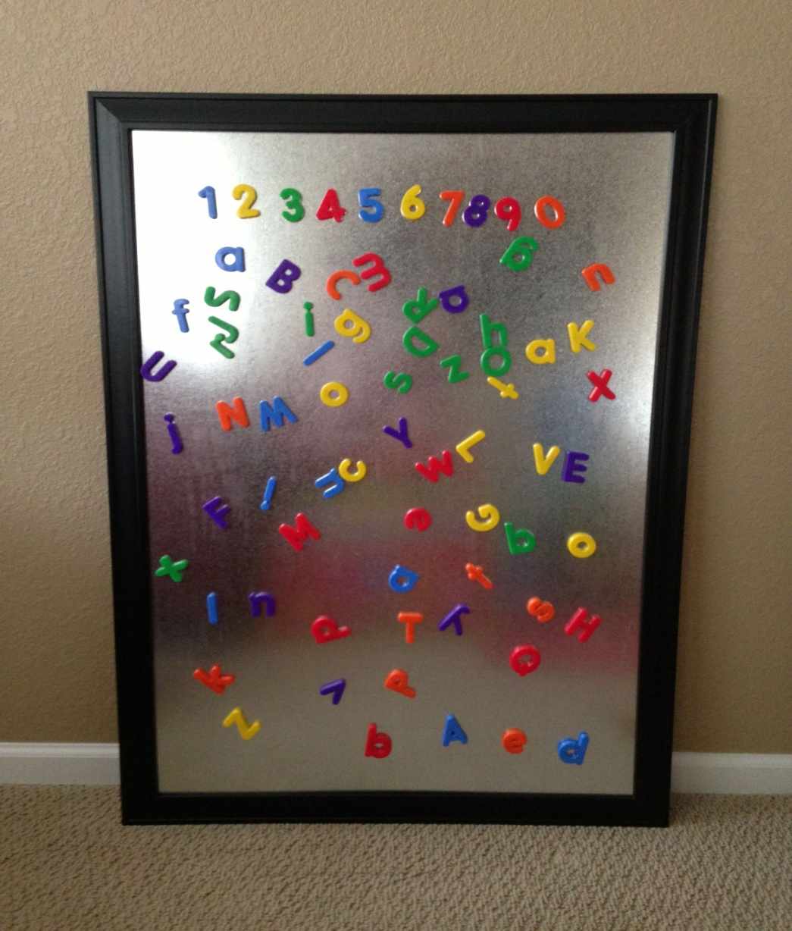
Image of used Magnetic Board
Dr. Mwancha - Education Department

Slide 42
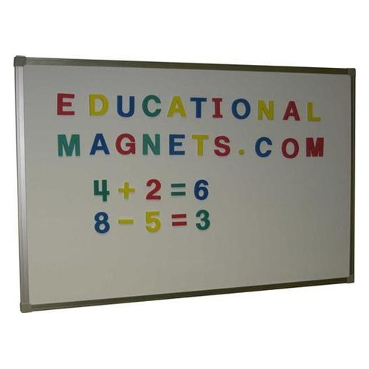
Dr. Mwancha - Education Department

Slide 43
Peg boards
Peg board is a non-projected display board with multiple small holes into which pegs can be inserted in different arrays so as to form hooks from which to hung tools and other objects for convenient access.
Peg boards are commonly mounted in workshops in learning institutions.
Dr. Mwancha - Education Department

Slide 44
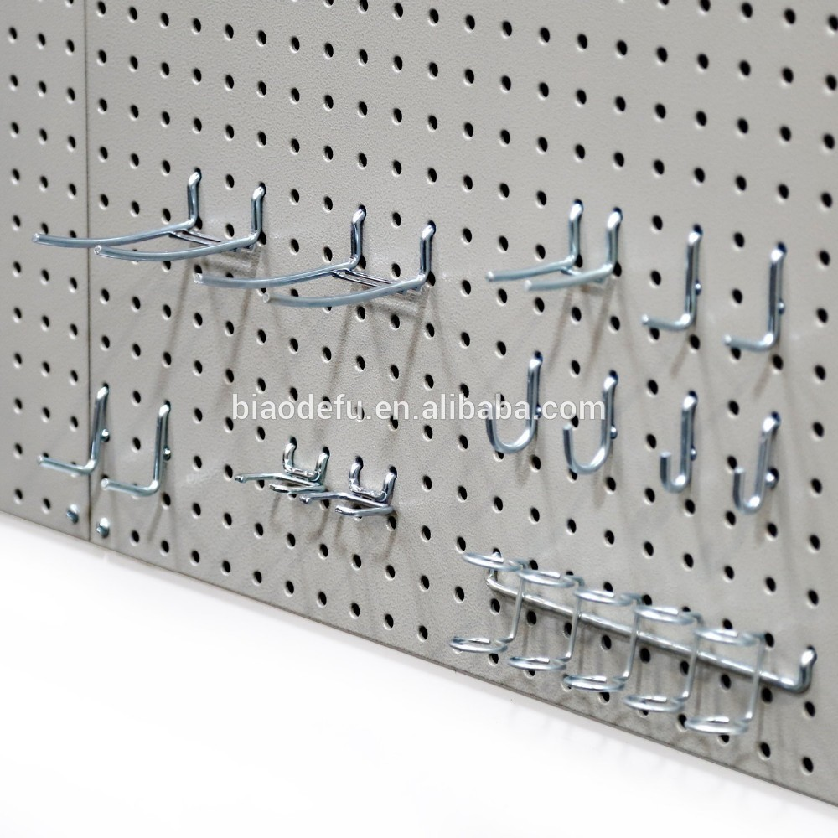
Image of a Peg board
Dr. Mwancha - Education Department

